Slide 1
Digital Portfolio
STUDENT NAME: Samiksha P
REGISTER NO AND NMID: 2426J1216 /1ED993FD39C83F0A74D4ED09772E7E0A
DEPARTMENT: Information Technology
COLLEGE: Akshaya college of art and science

Slide 2
PROJECT TITLE
Digital Portfolio

Slide 3


AGENDA
Problem Statement
Project Overview
End Users
Tools and Technologies
Portfolio design and Layout
Features and Functionality
Results and Screenshots
Conclusion
3/21/2024 Annual Review

Slide 4

PROBLEM STATEMENT
Many students and professionals struggle to showcase their skills and projects in an organized way.
Resumes alone are not interactive or visually appealing.
A portfolio website solves this by providing a personal online presence.

Slide 5

PROJECT OVERVIEW
Built with HTML, CSS, and JavaScript for responsiveness and clean design.
personal portfolio website designed to showcase skills, projects, internships,
and contact information.
Built with HTML, CSS, and JavaScript for responsiveness and clean design.
Includes sections like Home, Skills, Projects, Internship, About, and Contact.

Slide 6

WHO ARE THE END USERS?
Students → To present their skills and academic projects.
Job Seekers → To share portfolios with recruiters.
Freelancers → To display work samples for clients.
Recruiters/Employers → To evaluate candidate’s skills and achievements quickly.

Slide 7

TOOLS AND TECHNIQUES
Frontend: HTML5, CSS3, JavaScript
Design: Gradient themes (#44334A, #8D77A8, #D1C0EC)
Hosting (optional): GitHub Pages / Netlify
Version Control: Git & GitHub

Slide 8
POTFOLIO DESIGN AND LAYOUT
Navbar → Easy navigation with links to all sections.
Hero Section → Welcome message + profile image.
Skills Section → List of technical skills.
Projects Section → Display of completed projects.
Internship Section → Details of internship experience.
About Section → Short introduction and career goals.
Contact Section → Email and phone for communication.
Footer → Copyright information.
8

Slide 9
FEATURES AND FUNCTIONALITY
Responsive design (works on mobile, tablet, desktop).
Attractive gradient themes with customized color palette.
Smooth hover effects on buttons and project cards.
Profile image with circular frame and shadow.
Easy navigation through navbar links.

Slide 10
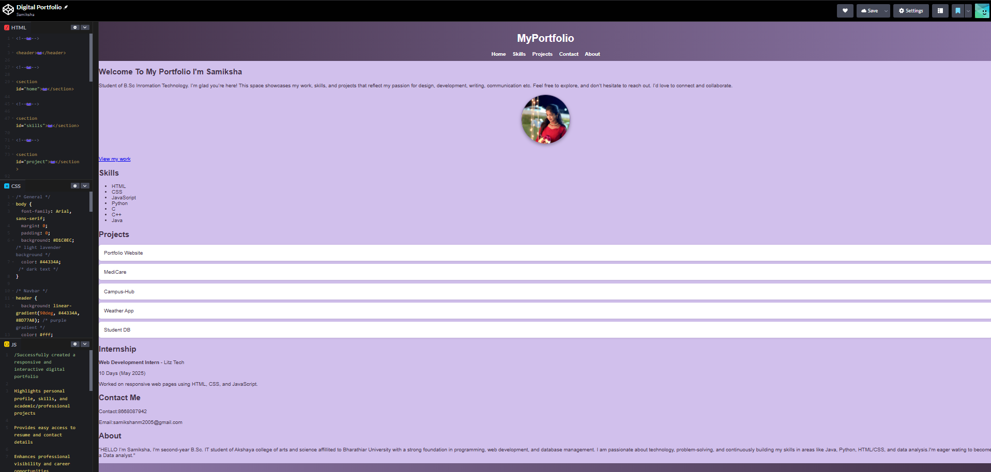
RESULTS AND SCREENSHOTS
10

Slide 11
CONCLUSION
Developed a personal portfolio website to present skills,
projects, and achievements.
Helps improve professional visibility and acts as an online resume.
Can be extended with blogs, certifications, or live project demos in the future.
11

